Slide 1

ECE 419/619 Electric Machines and Drives Mechanical Systems and Control

Slide 2
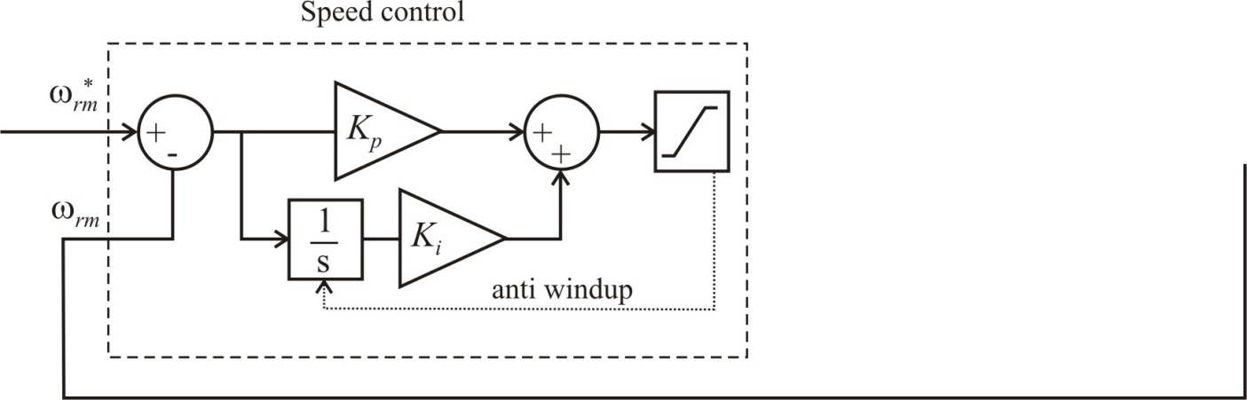
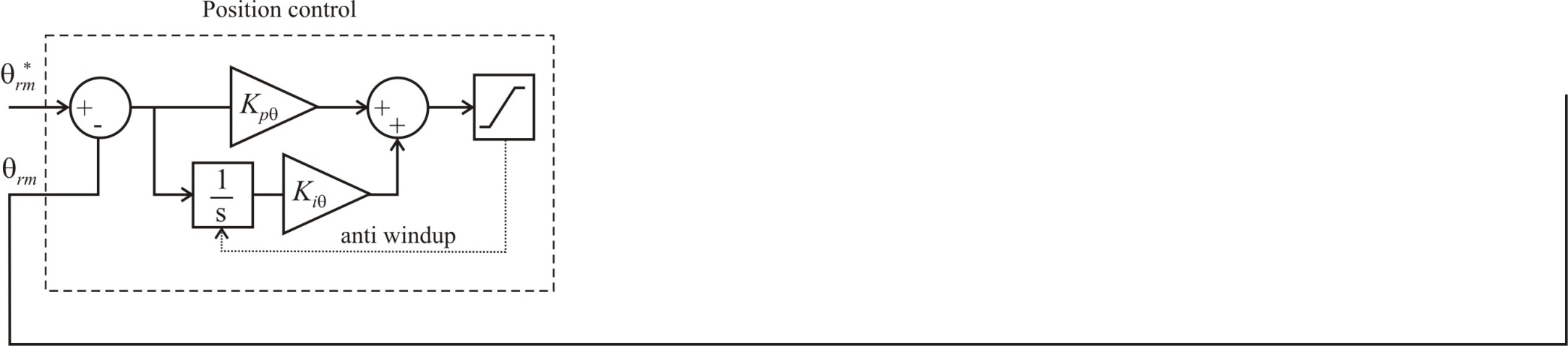
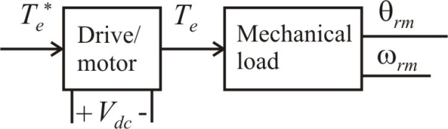
General Drive and Control Systems
System Control
Torque control - Torque directly controlled by the drive
Speed control - Typically an outer loop added to torque control
Position control - Typically and outer loop added to speed control
Mechanical Systems
Regulator applications - Keep output constant despite disturbances (Inertia helps)
Servo applications - Rapidly change system output (Inertia hinders)

Slide 3
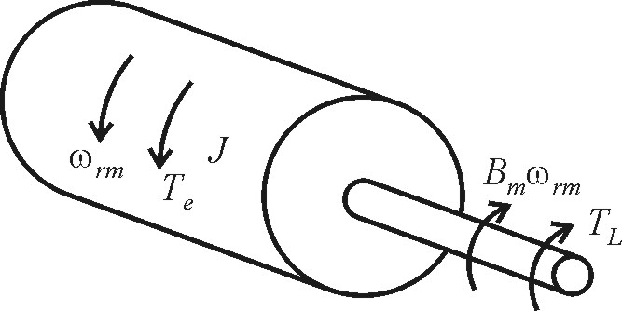
Motor Mechanical Equations
also
T_{e} - electrical torque (N∙m)
B_{m} - friction constant (Kg∙m²/sec)
J - total inertia (Kg∙m²)
ω_{rm} - mechanical speed (rad/sec)
T_{L} - load torque (N∙m)
θ_{rm} - mechanical rotor position (rad)

Slide 4
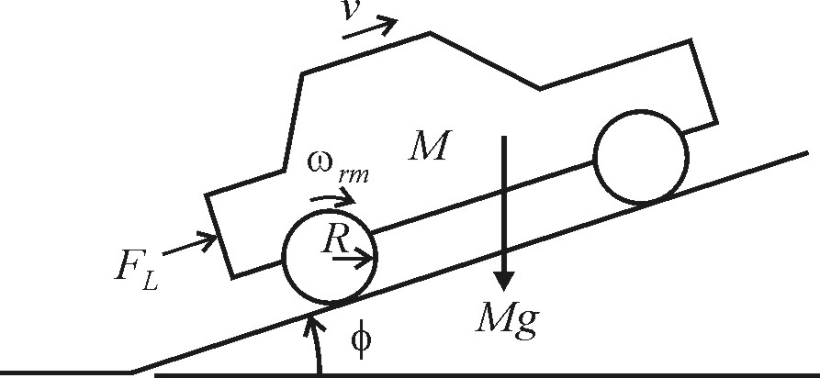
Electric Vehicle System
F_{L} - load force (N)
v - vehicle velocity (m/sec)
M - vehicle mass (kg)
g - acceleration constant, g = 9.8 m/sec²
R - wheel radius (m)
φ - incline angle (rad)
D - vehicle friction and windage constant (kg/sec)

Slide 5
Vehicle Equations
motor mechanical equation
assuming no tire slip

Slide 6
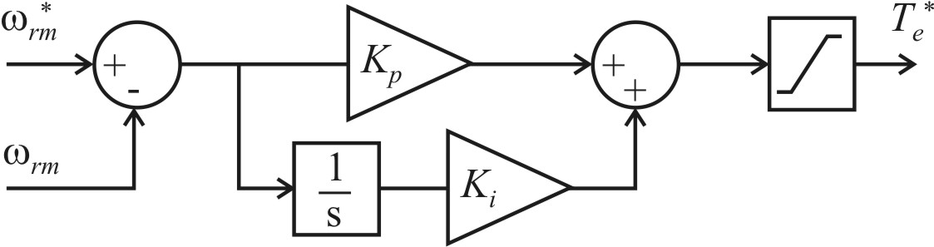
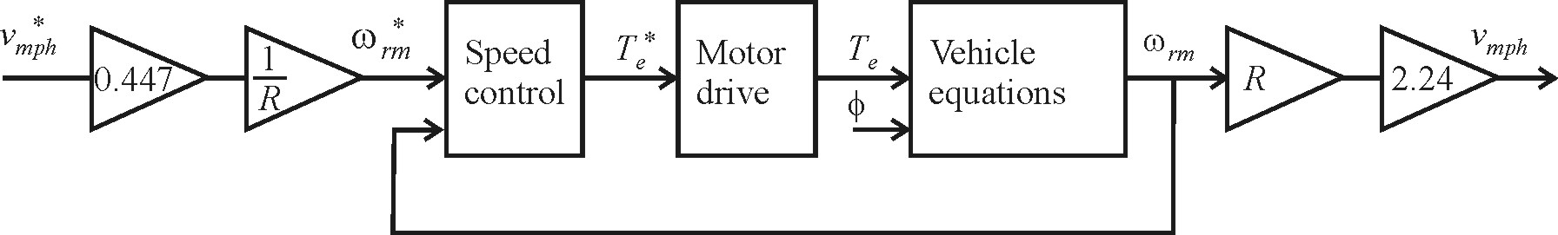
Vehicle Speed Control
Speed control
Regulator application
drive simulation structure
for an ideal motor drive,

Slide 7
Example Calculations

Slide 8
Steady-State Mechanical Calculations

Slide 9
Simulink .m File
g = 9.8;
% vehicle parameters
M = 1570;
D = 0;
R = 0.2;
phi_deg = 15;
tstep = 15;
% motor parameters
J = 0.38;
Bm = 0;
% control parameters
v_mph = 60;
taccelerate = 9;
% over-damped response
Kp = 50;
Ki = 10;
% under-damped response
Kp = 50;
Ki = 1e3;
% well-tuned response
Kp = 10e3;
Ki = 1e3;

Slide 10
Simulink Simulation
Commanded speed
Speed control
Ideal drive
Conversion

Slide 11
Vehicle Equation Simulation

Slide 12
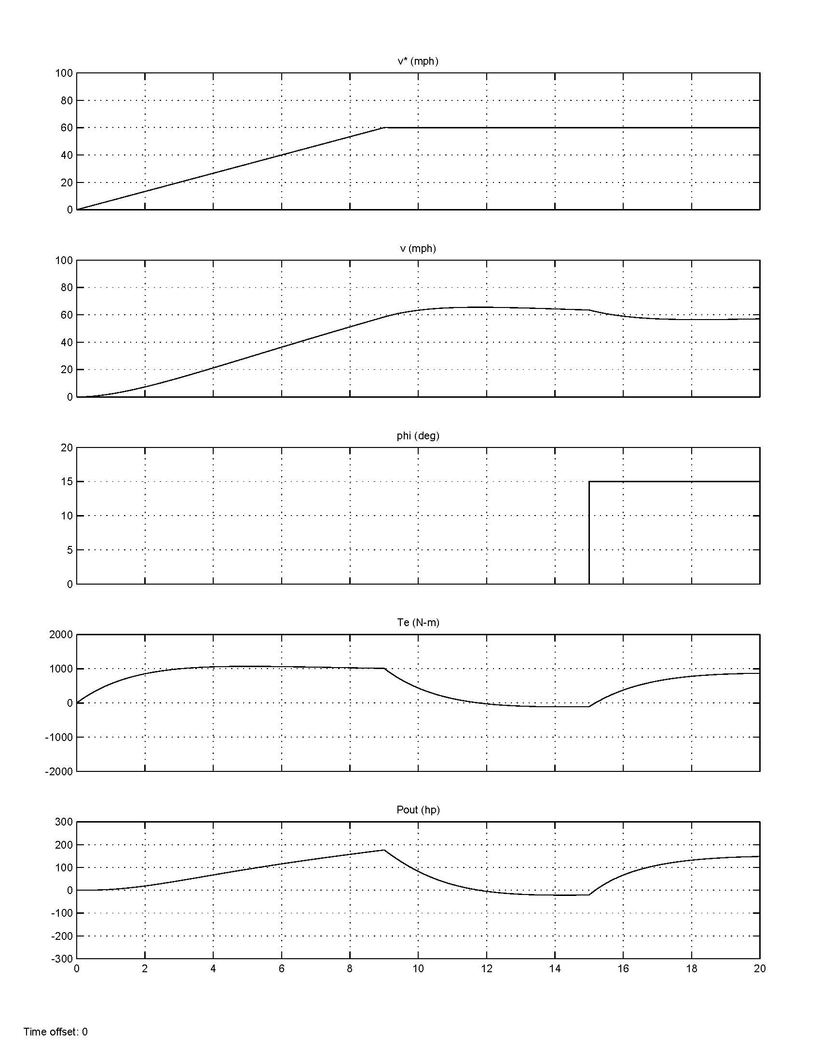
Over-Damped Response
K_{p} = 50
K_{i} = 10

Slide 13
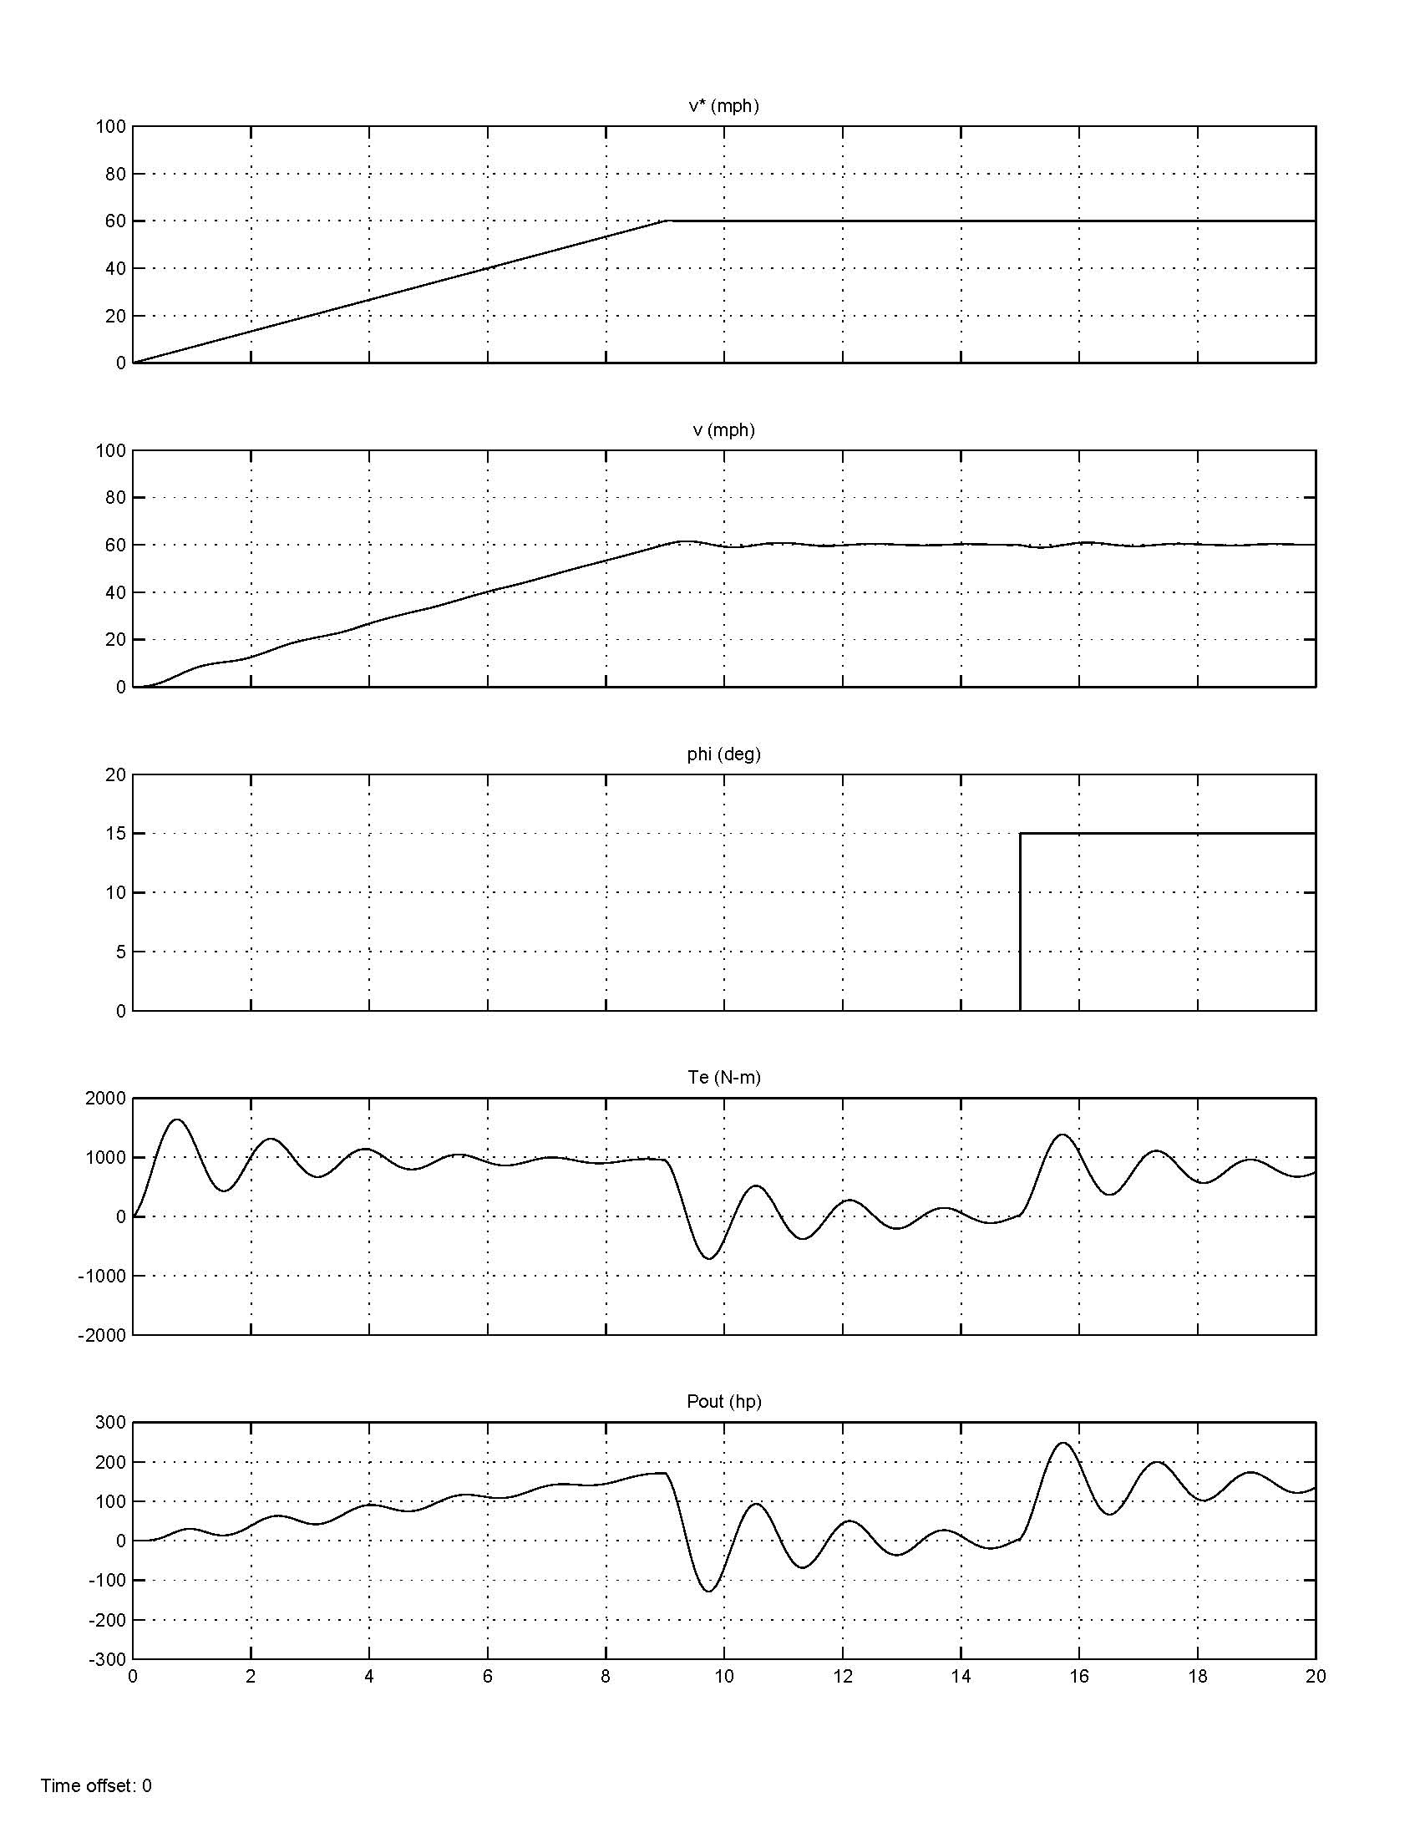
Under-Damped Response
K_{p} = 50
K_{i} = 1e3

Slide 14
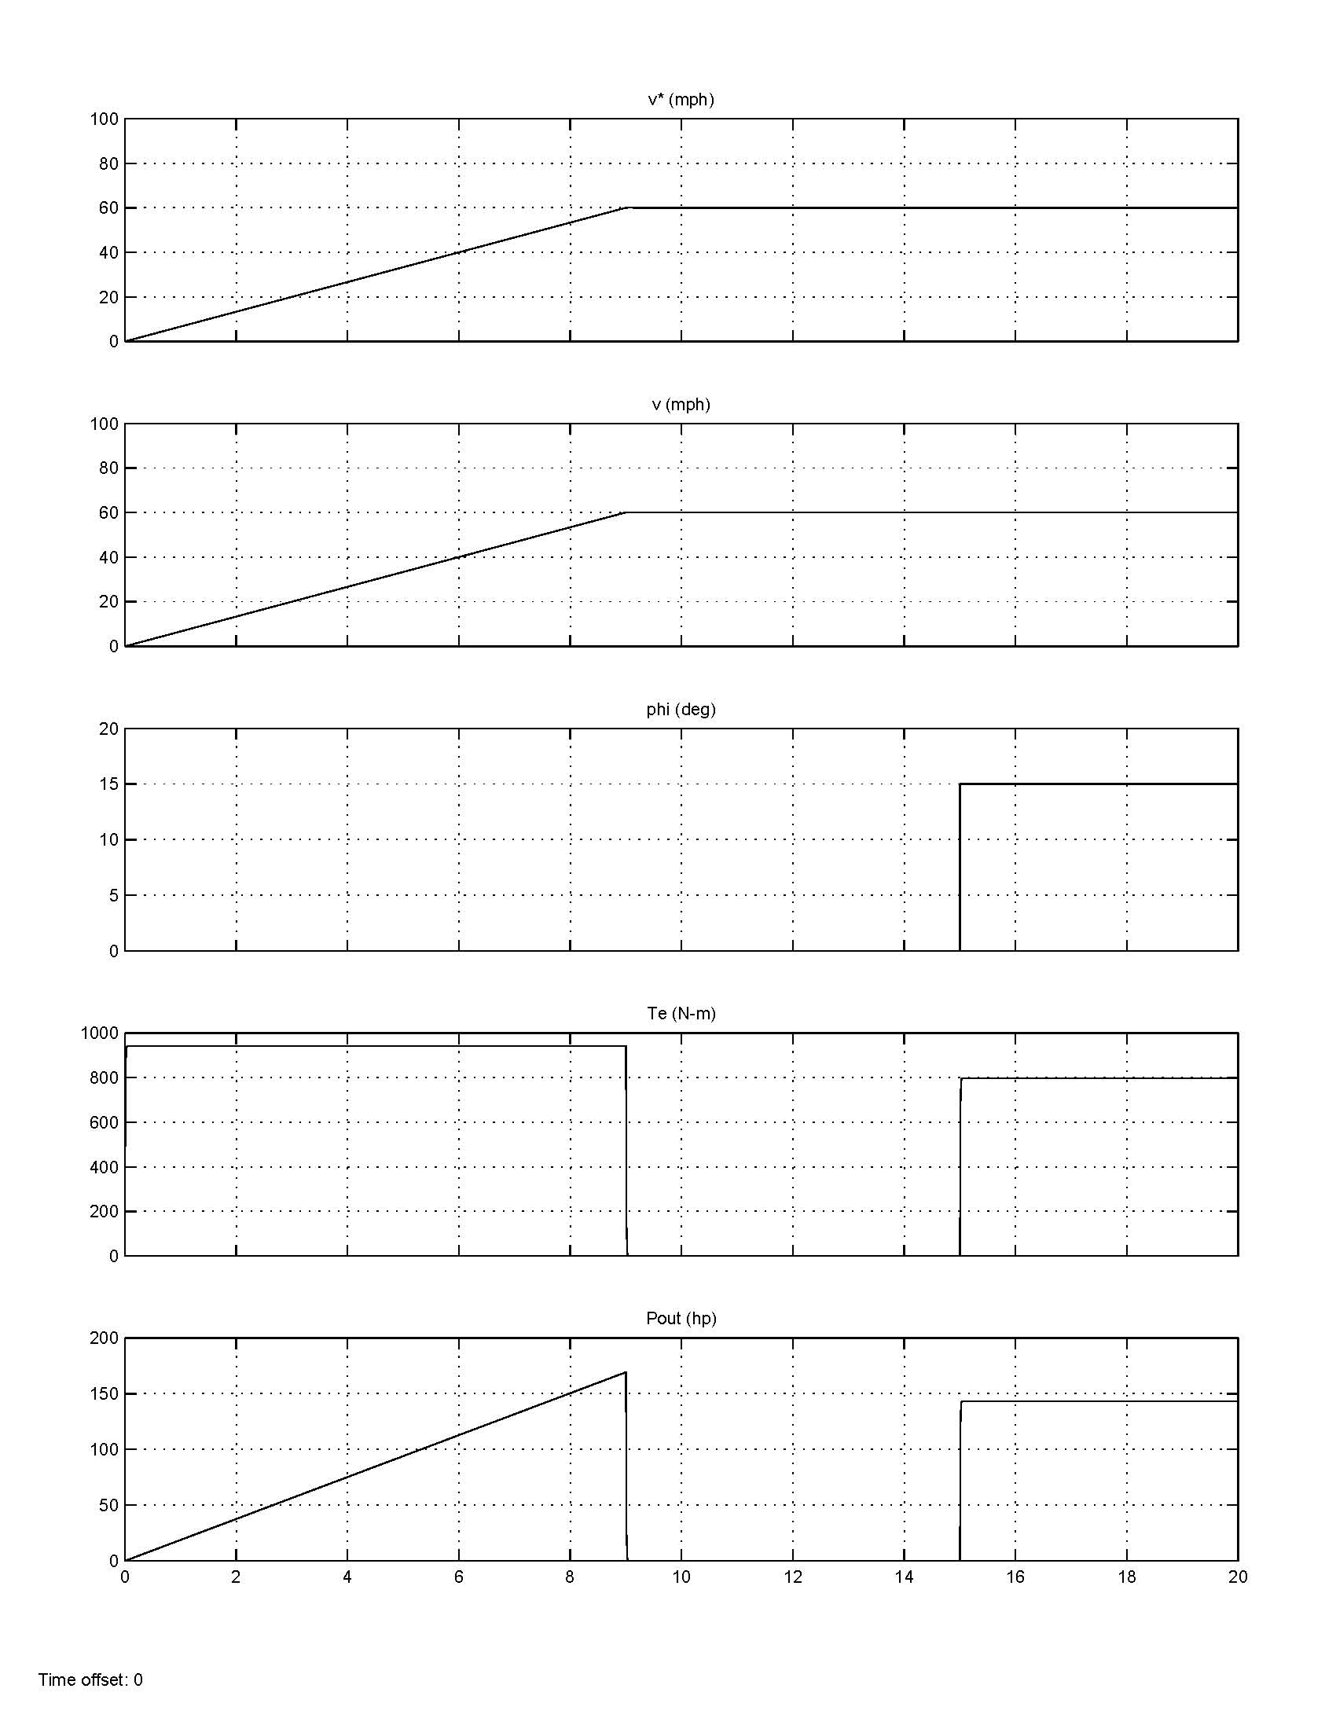
Well-Tuned Response
K_{p} = 10e3
K_{i} = 1e3

Slide 15
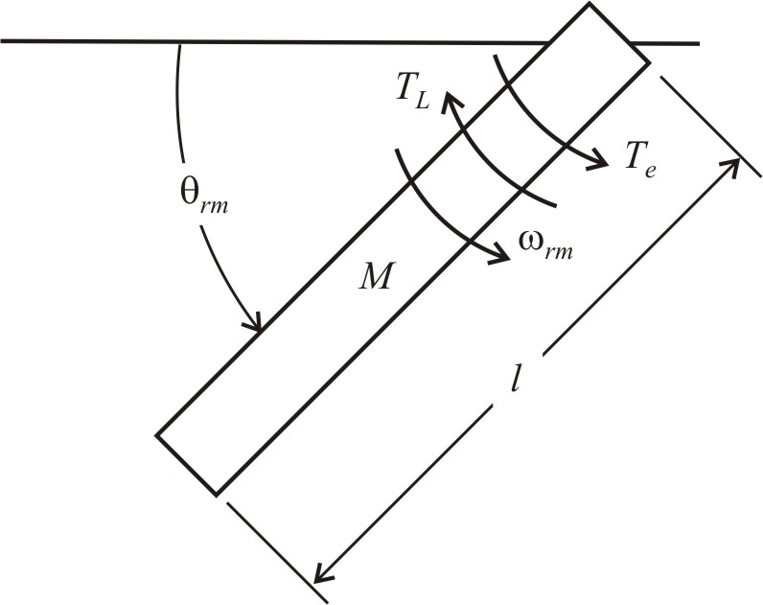
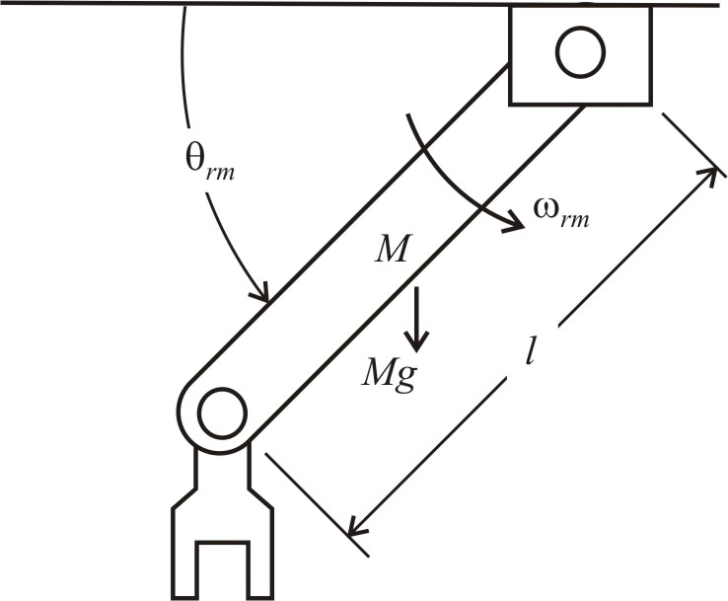
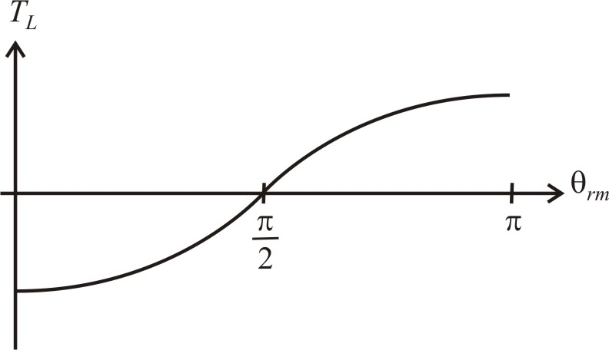
Robot Arm
Free body diagram
Position control
Servo application
Load torque

Slide 16
Simulink .m File
g = 9.8;
% robot arm parameters
M = 2;
l = 0.6;
% motor parameters
J = 0.38;
Bm = 0;
% system parameters
Jr = J + (M*l^2)/3;
Qrm_initial = pi/2;
% control parameters
theta_max = pi/4;
t_start = 1;
t_move = 0.5;
t_hold = 2;
tau = 0.1;
% control gains
Kp = 100;
Ki = 100;
Kpq = 10;
Kiq = 10;

Slide 17
Simulink Simulation
Commanded position
Position control
Speed control

Slide 18
Robot Arm Equations

Slide 19
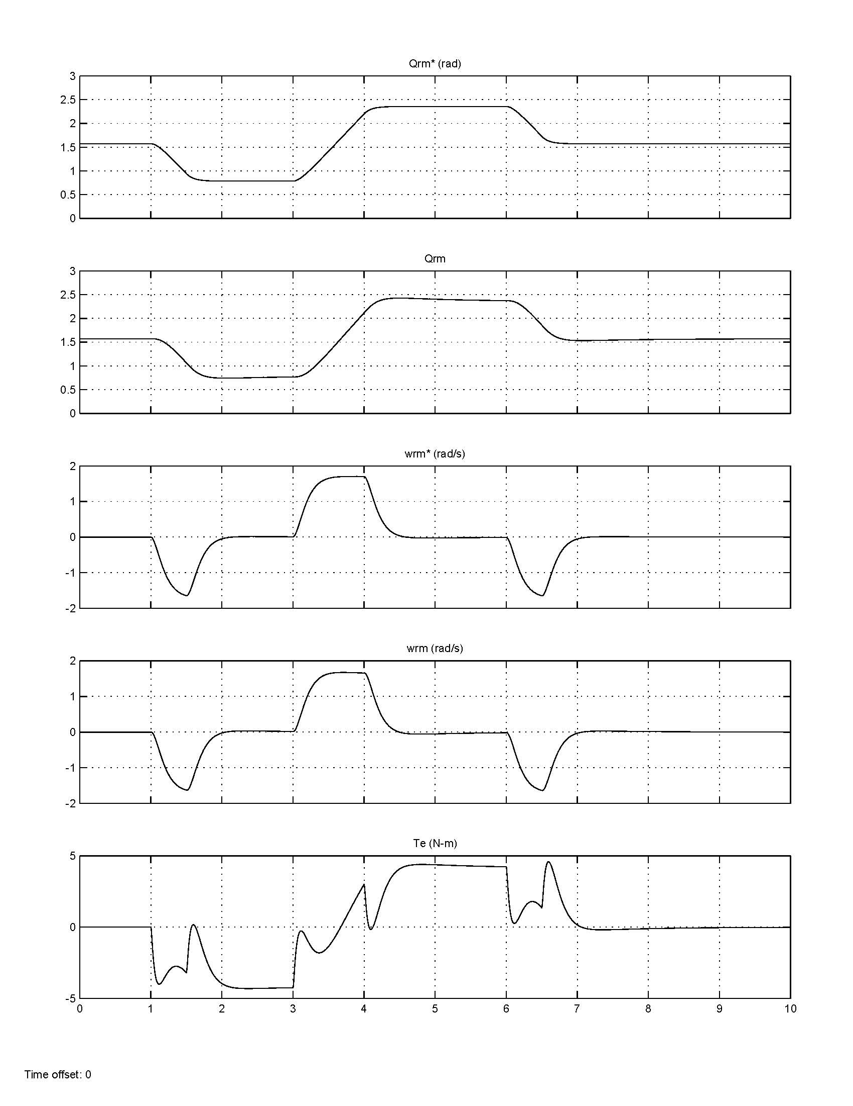
Robot Arm Simulation Waveforms

